Slide 1
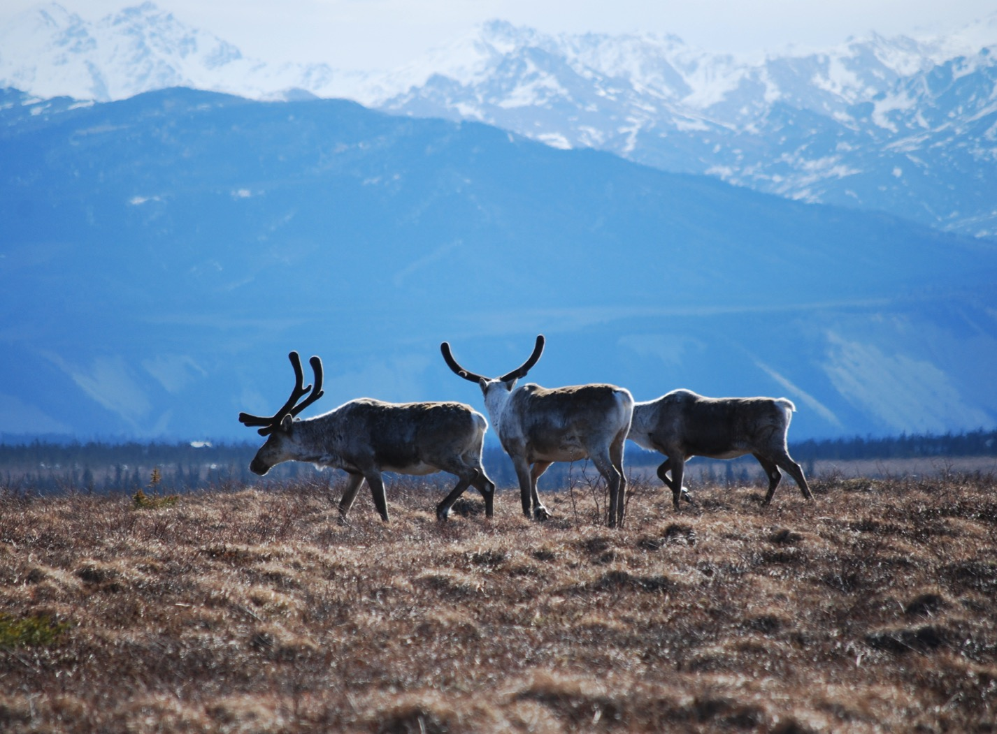
Arctic Boreal Vulnerability Experiment (ABoVE)
2017 ABoVE Airborne Campaign
13 June 2017 (DOY 164)
UAVSAR: Palmdale – Yellowknife Transit
Charles Miller, Deputy Science Lead
Jet Propulsion Laboratory, California Institute of Technology
and the ABoVE Science Team For Hank Margolis, Eric Kasichke, Bruce Tagg
NASA HQ
2017

Slide 2
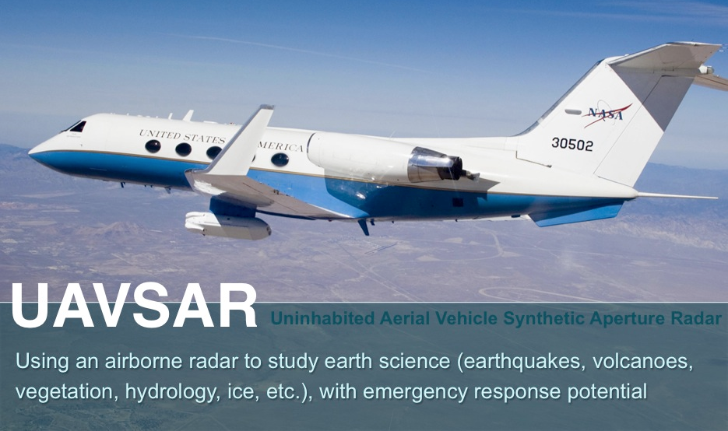
13 June 2017/DOY 164 Palmdale – Yellowknife Transit
Daily Summary:
C-20A (N30502) UAVSAR ABoVE CAMPAIGN (CANADA / ALASKA)
REPORT DATE: 13 June 2017
Current Status of Aircraft: GREEN
Current Status of SAR: GREEN
Current Status of PPA: GREEN
Current Deployment Location: Yellowknife NT (CYZF)
Crew: Asher, Barry, Meza, Salazar, Griffith, Choi, Miller, Moreno, Tan, McGrath
Science Coordinator: N Pinto
Science Lead: M Moghaddam
Project Manager: Y Lou

Slide 3
13 June 2017/DOY 164 Palmdale – Yellowknife Transit
Daily Summary:
Transit + Science Flight – Palmdale (KPMD) to Yellowknife (CYZF) – 5.7 hrs
Great flight
Collected 7 of 7 data lines
Ft. McMurray, Peace-Athabasca Delta, Ft. Smith
Flight Plan – 1134v02
Flight, which was delayed by one day from the original 12 June 2017 plan, was successful. The first line had a radar flatline, which may have been rescued. But we won’t know until we see the quickbooks later this week.
Other lines were flown successfully.
Colorado lines were skipped and airplane landed in Yellowknife as port of entry into Canada.
Radar quick look data processing won’t commence until after transit to Fairbanks, as crew has determined offloading-uploading of heavy hardware is not worth the effort during Yellowknife stopover..

Slide 4
12 June 2017/DOY 163 72-Hour Look Ahead
All plans weather dependent
Wednesday 14 June 2017 (DOY 165):
Great Slave Lake/Upper Mackenzie River/Daring Lake
Flight Plan https://uavsar.jpl.nasa.gov/cgi-bin/report.pl?planID=PLAN_1120_v01#summary
Thursday 15 June 2017 (DOY 166):
Yellowknife NT – Fairbanks AK
Friday 16 June 2017 (DOY 167):
Southwest Alaska

Slide 5
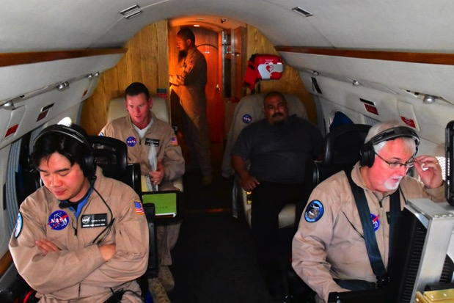
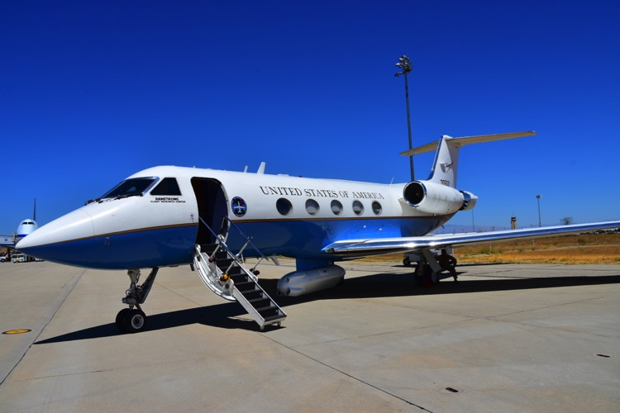
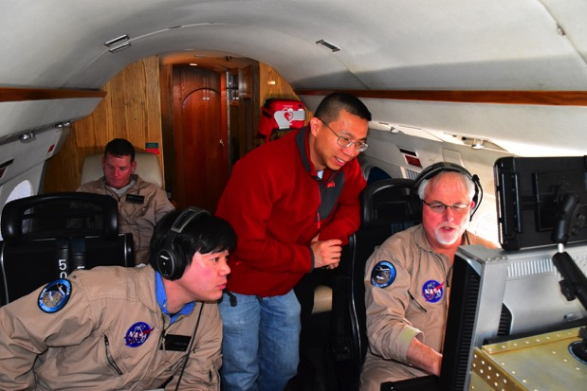
13 June 2017/DOY 164 Palmdale – Yellowknife Transit
Stevens Village
Beaver
NASA 502 and UAVSAR team make their way from Palmdale over the Peace-Athabasca Delta and Slave River to Yellowknife
Kotzebue

Slide 6
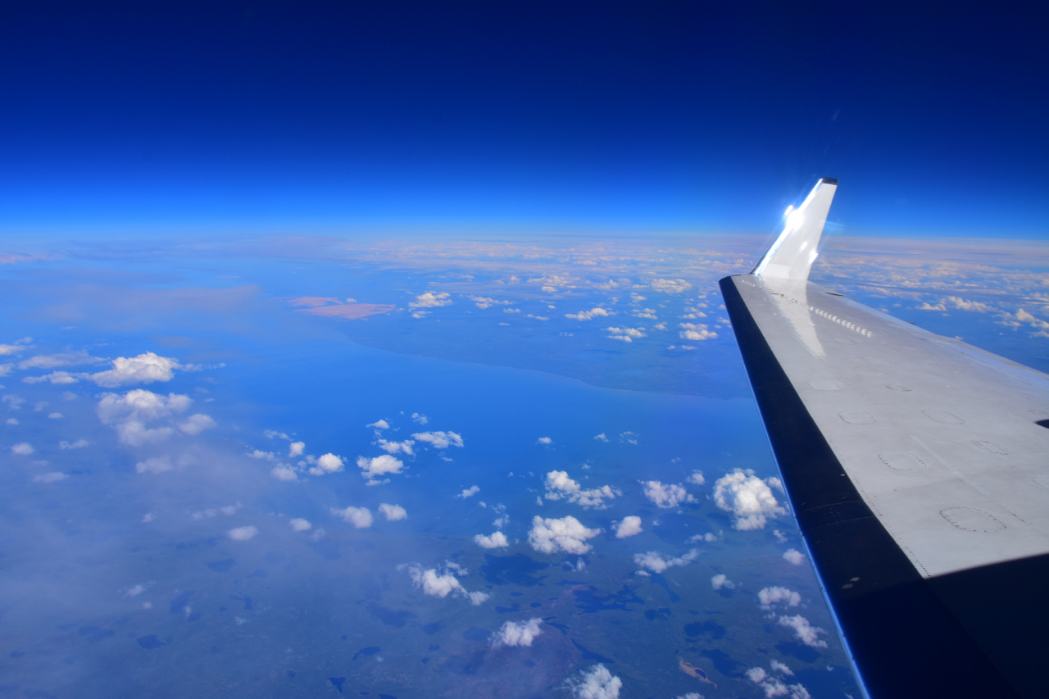
13 June 2017/DOY 164 Palmdale – Yellowknife Transit
The Peace-Athabasca Delta
Stevens Village
Beaver
Kotzebue
NASA 502 and UAVSAR team make their way from Palmdale over the Peace-Athabasca Delta and Slave River to Yellowknife

Slide 7
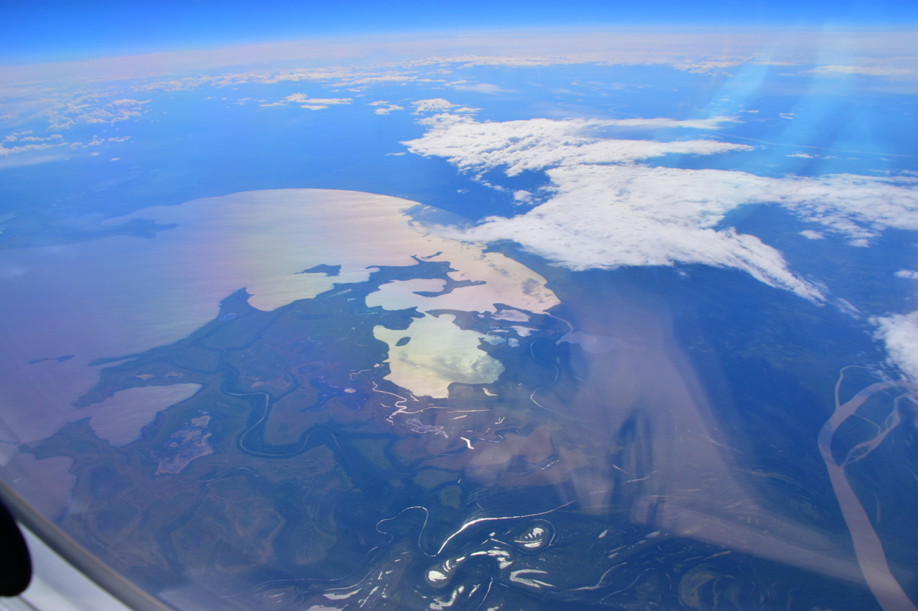
13 June 2017/DOY 164 Palmdale – Yellowknife Transit
The Peace-Athabasca Delta
Stevens Village
Beaver
Kotzebue

Slide 8
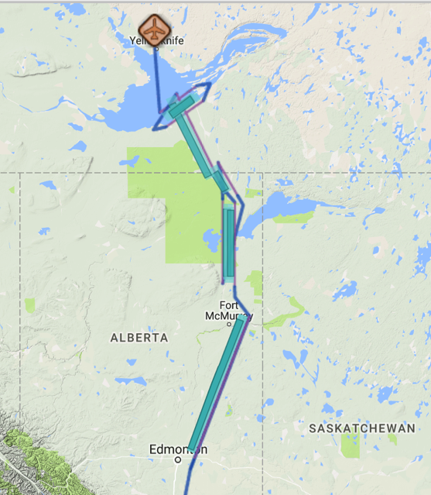
13 June 2017/DOY 164 Palmdale – Yellowknife Transit
Flight Plan 1142 v02, Report 17063: Yellowknife NT (CYZF) – CYZF
https://uavsar.jpl.nasa.gov/cgi-bin/report.pl?planID=PLAN_17063#flightPlan
6/13/17 flight plan & acquisition segments
Data Acquisitions:
Line 1, ID 02111: Fort McMurray
Line 2, ID 36000: PAD 1
Line 3, ID 18035: PAD 2
Line 4, ID 32911: Fort Smith 1
Line 5, ID 33410: Fort Smith 2
Line 6, ID 05530: Fort Resolution 1
Line 7, ID 23404: Fort Resolution 2
05530
23404
33410
32911
36000
18035
02111
Notes:
PLAN_1140_v02. Changes to V1: matched lines to P-band lines in 1121_v01.
\

Slide 9
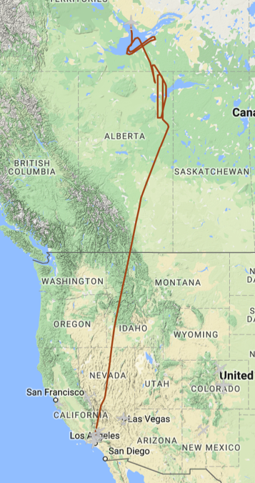
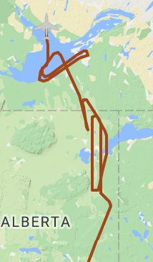
13 June 2017/DOY 164 Palmdale – Yellowknife Transit
Flight Plan 1134 v02, Rep 17062: Palmdale (AFRC) – Yellowknife (CYZF)
https://uavsar.jpl.nasa.gov/cgi-bin/report.pl?planID=PLAN_17062#flightPlan
6/13/17 As-flown lines & acquisition segments
Data Acquisitions:
Line 1, ID 02111: Fort McMurray
Line 2, ID 36000: PAD 1
Line 3, ID 18035: PAD 2
Line 4, ID 32911: Fort Smith 1
Line 5, ID 33410: Fort Smith 2
Line 6, ID 05530: Fort Resolution 1
Line 7, ID 23404: Fort Resolution 2
05530
23404
33410
32911
36000
18035
02111

Slide 10
13 June 2017/DOY 164 Palmdale – Yellowknife Transit
UAVSAR Quick-look products
Line 1, ID 02111: Fort McMurray
Line 2, ID 36000: PAD 1
Line 3, ID 18035: PAD 2
Ian Tan, JPL
A
B
C
Notes:
Burns near Fort McMurray seen as red/orange colors
B & C. Multiple passes of the Peace-Athabasca Delta

Slide 11
13 June 2017/DOY 164 Palmdale – Yellowknife Transit
UAVSAR Quick-look products
Line 4, ID 32911: Fort Smith 1
Line 5, ID 33410: Fort Smith 2
Ian Tan, JPL
A
B
Notes:
Images of the Slave River from the Fort Smith area (A) all the way to the Slave River Delta/Fort Resolution area (B)

Slide 12
13 June 2017/DOY 164 Palmdale – Yellowknife Transit
UAVSAR Quick-look products
Line 6, ID 05530: Fort Resolution 1
Line 7, ID 23404: Fort Resolution 2
Ian Tan, JPL
A
B
Notes:
A & B. Slave River Delta/Fort Resolution area (panel B has been flipped 180 degrees to align the composite)

